Slide 1
Module 3: SQL 3
Capstone Project 3
Notes:
Title slide

Slide 2

Part-III
School Management System

Slide 3
Quick Intro on School Management System
Consider a fictional School “ABC Public School” situated in Delhi-NCR. This school has classes from 6th standard to 10th standard but they have just started gathering all the school data in a database. Therefore, we have limited data for class 8th, 9th and 10th.
In this problem, school management wants to input the data in database quickly and efficiently so that they will get quick and actionable insights as fast as possible.
You have been hired as a data scientist and it's your responsibility to not only create the database but also get actionable business insights for the stakeholders.

Slide 4
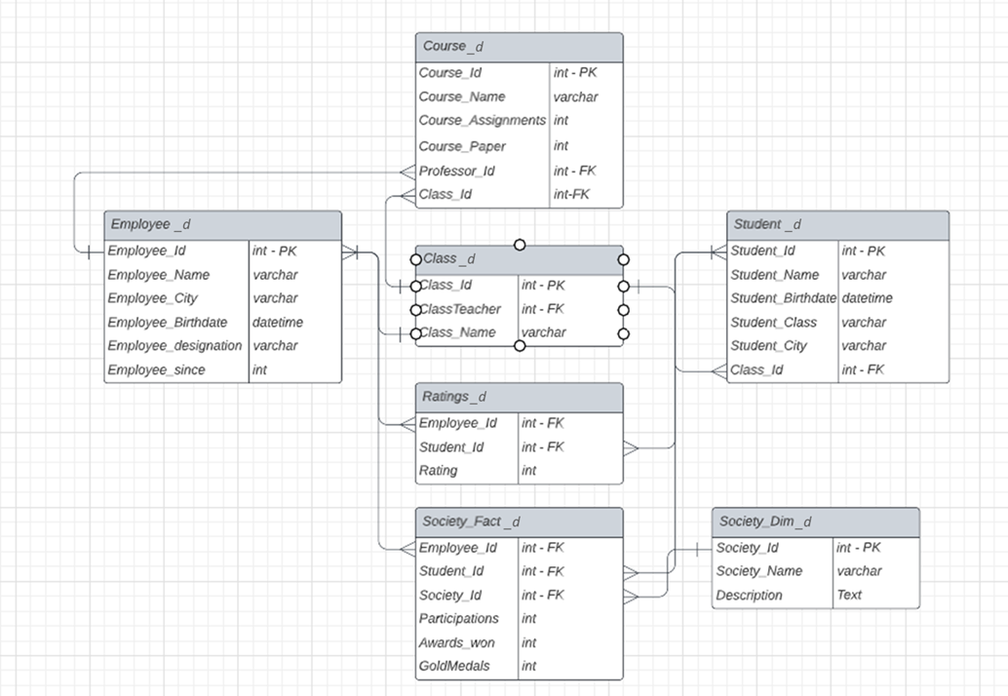
Let’s revisit the School schema once more…
Please find the associated tables in Metabase, inside the “MYSQL” database.
Use the tables to perform the tasks in this capstone. To learn more about Metabase, please refer to the Introduction to Metabase (A Tool to Interact with SQL) lesson on the module.

Slide 5
Section 1
Consider the scenario that School has to fund different societies within the school. They have to identify certain characteristics of each society in order to determine the allocation of funds. Answer the following:
Get the top 1 society [Id] with
Highest Student Strength (with/without order by and limit)
Highest Awards Won (with/without order by and limit)
Highest Avg Gold Medal Winning Percent out of all awards [Gold Medal / Awards Won] (with/without order by and limit) [Hint: Use round function in subquery part]
Identify the society name with highest and lowest mean winning percentage [Awards Won / Participation]. [Hint: There are 2 different questions in this one]
Identify individual student’s contribution in fraction within total awards that are won.

Slide 6
Section 2
School also has a lot of administrative work. Let’s figure out how we can distribute that amongst the employees depending on their availability:
Identify the employee ids that aren’t involved with either in classes or any societies and order them in DESC order by the time they spend in the school. [YEAR(NOW()) - Employee_since].
Identify the employees who aren’t involved with either in classes or any societies as of now [using JOINs] with
Group by designation with total number of employees and avg fraction belonging to that designation. [If there are 2 assistants and 1 is not involved in anything then this fraction would be 0.5 based on assistant designation]
The names of top 2 designation groups based on above defined fraction. Arrange by designation if there is a tie.
Notes:
Employees and students not participating in any of the societies

Slide 7
Section 3
Evaluate the following:
Length of Description within Society Dim and get the average length of this column. [These are 2 different questions]
Check out if there is any form of error in the description column by identifying the leading or trailing spaces if any in any row. [This is a yes and no question with query, don’t need to give the output in result]
Wherever we have “event” in place of “events” in description. Replace it with “events” in select clause.
The fraction of events where candidates has not won the awards rounded off to 1 decimal value and ordered in ASC order along with gold medals that they have won in DESC order.
Get the total number of employees from each city and identify which of them are even and which of them are odd.
Let’s suppose we have to create banners for each society in the form of “Society_Id - Society_Name - headed by Employee_Id”. Please print it out for all 5 societies. [Hint: Use DISTINCT]

